Slide 1



Gujarat Global Capability Centre Policy (2025-30)
Presented by:
Ms. P. Bharathi, IAS
Secretary, DST, GoG

Slide 2












India – The GCC Capital of the World
Global Capability Centre
(GCC) market size
Expansion in India by 2030
$ 110 Bn
GCC Market Size by 2030
2400 GCCs by 2030
115 new GCC Set-ups every year
4.5 Mn
Total headcount
$64.6 billion in revenue-FY 2024
Employs over 1.9 million people
In India, states like Gujarat, Karnataka, Uttar Pradesh, Madhya Pradesh and Andhra Pradesh

Slide 3

Growth Enablers for GCCs in India
Expansion into Tier-II and Tier-II cities
Focus on Digital and Emerging Tech
Talent Transformation and Leadership Roles
Proactive Govt. Support
Moving beyond Bengaluru, Hyderabad, Pune, and Gurugram
Rising Costs and saturations in metros
Ahmedabad, Surat and Vadodara are rising stars.
Moving beyond transactional roles to deep tech and innovation hubs
Key focus areas – AI, Cloud, Semiconductors, Industry 4.0
By 2030, 65% of new GCCs are expected to have emerging tech CoEs
Moving beyond execution roles to product ownership, global R&D, strategy and design
Increasing presence of CXO level decision making roles in India based GCCs
Recognized as key area for policy support
MeitY and several states fuelling faster growth
Ecosystem linkages

Slide 4







Gujarat: Competitive Advantages for GCCs
1
A key economic powerhouse of India
Manufacturing and Exports Hub
$309.52 Bn, 8.6% of India’s GDP (FY 23-24)
30.75% share in India’s total exports (2023-24)
19% share in country’s manufacturing GDP
2
World-Class Infrastructure
$44.91 Bn FDI, (Oct 2019-March 2025)
US$ 3,587 Per capita income in 2023-24)
Service Sector contributed 35.8% to the state’s GSDP
3
Proactive Governance, Unmatched Ease-of-Doing Business, Progressive Policies
Ecosystem
Pro-active Government
Sectoral Leadership
4
Talent Pool from Premier Institutions – IIM-A, IIT-Gn, IIIT-V, GTU, Nirma, DAIICT,
NFSU, MSU, PDEU, CEPT and others.
Futuristic Infrastructure
Sustainability
Ease of Living/ Social Life
Source: Gujarat Socio-Economic Review 2024-25

Slide 5
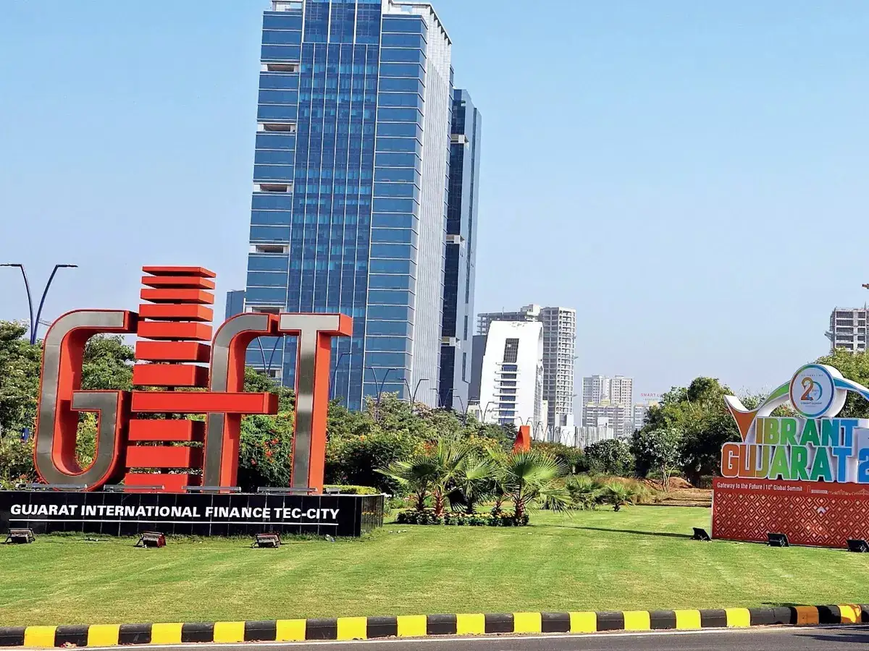
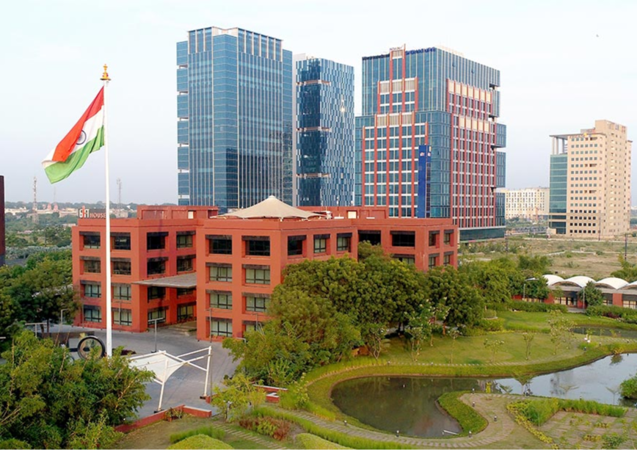
GIFT City – Distinct Edge for GCCs
Business District
GIFT City offers an ideal platform for IT & ITeS, Electronics System Design, IC Design, Research organizations and back offices for engineering/ automobiles, medical devices, and biotechnology.
One of Gujarat’s most impactful contributions to the GCC ecosystem is the establishment of Global In-House Centres (GICs) at the International Financial Services Centre (IFSC) within the GIFT City.
Strategic location
IFSC & Regulatory Edge
Smart City Benchmark
Smart Digital infrastructure
Tax & Business Incentives
Excellent Connectivity
Modern Urban Architecture
Rapid Ecosystem Growth
Walk to Work

Slide 6

Gujarat Global Capability Center (GCC) Policy (2025 - 30)
To position Gujarat as a leading destination for high-value Global Capability Centers by fostering innovation and enabling a world-class ecosystem that promotes sustainable growth, employment generation, and global competitiveness.
VISION
Establish Gujarat as a preferred GCC hub
To Align with Global value chain
OBJECTIVES
Promote high-value jobs and skill development
Foster innovation and digital transformation
Enhance infrastructure and connectivity
Sustain economic growth and global competitiveness
Notified on 11 February, 2025.

Slide 7
Eligible GCC Activity Domains
Information Technology (ITeS)
Banking, Financial Services & Insurance (BFSI)
Digital Transformation
Telecom & Networking
Semiconductors & Electronics
Cybersecurity & Compliance Functions
Data, AI & Analytics Functions
Automotive & Mobility
Legal, Consulting and Professional Services
Industrial Engineering & Manufacturing
Retail and eCommerce
FMCG & Consumer Products
Fintech
Aerospace & Defense
Pharmaceuticals & Life Sciences

Slide 8
CAPEX Support
CAPEX support
@ 20% for Non-IT infrastructure
@30% for IT infrastructure
CAPEX Components
Expenditure on GFCI: Construction and Purchase of the building, Computers, Software, Networking related hardware and other related fixed assets (excluding the cost of land)
Stamp Duty and Registration Fees
Renewable Energy Expenditure
Up to INR 50 Cr for Category I units with GFCI < INR 250 Cr.
Up to INR 200 Cr for Category II- Mega Projects with GFCI >= INR 250 Cr.

Slide 9
OPEX Support
OPEX support @ 15%.
Bandwidth & Cloud Rental capped up to 35% of the eligible OPEX
OPEX Components
Cloud
Rental
Patent Support
Up to INR 20 Cr for Category I units with GFCI < INR 250 Cr.
Up to INR 40 Cr for Category II- Mega Projects with GFCI >= INR 250 Cr.
Lease Rental
Bandwidth
Power Tariff

Slide 10

Special Incentives
Employment Generation Incentive (EGI)
Atmanirbhar Gujarat Rojgar Sahay
Interest Assistance
Electricity Duty Incentive
One- time support for new job creation @ 50% of CTC
Up to INR 60,000 for female employees
Up to INR 50,000 for male employees
EPF support for a period of five years
@100% for female employees
@75% for male employees
@7% on term loan
Up to INR 1 Cr. per annum for 5 years Expenses made for GFCI
100% exemption from Electricity Duty for 5 years

Slide 11

Other Incentives
Skilling of Local Talent
01
Quality Certification
02
Incentives under Gujarat IT/ ITeS Policy (2022-27)
03
Direct Benefit Transfer (DBT) of up to INR 50,000:
50% for working professionals.
75% for undergraduate students / graduate students.
80% reimbursement
Up to INR 10 lakh.
For up to 5 certifications.
GCCs can claim incentives under
ICT & Deep Tech Incubators.
ICT & Deep Tech Accelerators.
Startups using GCC incubation/acceleration can avail incentives under ICT & Deep Tech Startups.

Slide 12


Let’s Connect !
Principal Secretary
Department of Science and Technology, Government of Gujarat
Email: secdst@gujarat.gov.in
Contact No. +91-79-23259999
dstGujarat
Mission Director
Gujarat State Electronics Misson, DST
Government of Gujarat
Email: md-gsem@gujarat.gov.in
Contact No. +91-79-23250463
GSEM_DST

