Slide 1
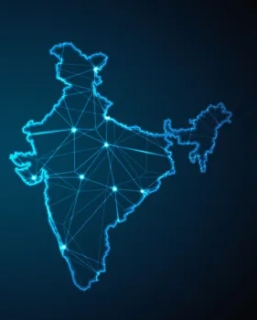
The Rise of GCC:
Building India as a Global Capability Hub
ICAI GCC Summit 2025
29th August, Ahmedabad
By Rakesh Sinha,
Founder & CEO, Quintes Global

Slide 2

3+ decades of GBS/ GCC Industry
Building India as the GCC Hub
Opportunities for CAs and Advisory Firms

Slide 3
In Your Opinion ….Why do Organizations Setup Global Capability Centers (GCC)?
Consolidate & Offshore Transactional Work
Cost Optimization
Efficiencies & Enhanced Customer Experience
Access to Talent Pipeline & Specialized Skills
Innovation Continuum & Strategic Decision Making
Market Expansion & Competitive Edge

Slide 4

3+ Decades of GBS/ GCC Industry
Started with Labour arbitrage and the Lower- end of transactions
Journey: Engineering Services / Shared Services → Business Services → Global In-house Centers → Global Capability Center
Most of us ‘landed by accident’ …..however built our Identity & Brand by Reinventing & Repositioning
India leads globally with 1,900+ GCCs, employing over 2 million professionals.
These centres now contribute USD 46 billion to India’s economy – expected to cross USD 100 billion by 2030.
Cost → Talent → Value → Innovation

Slide 5
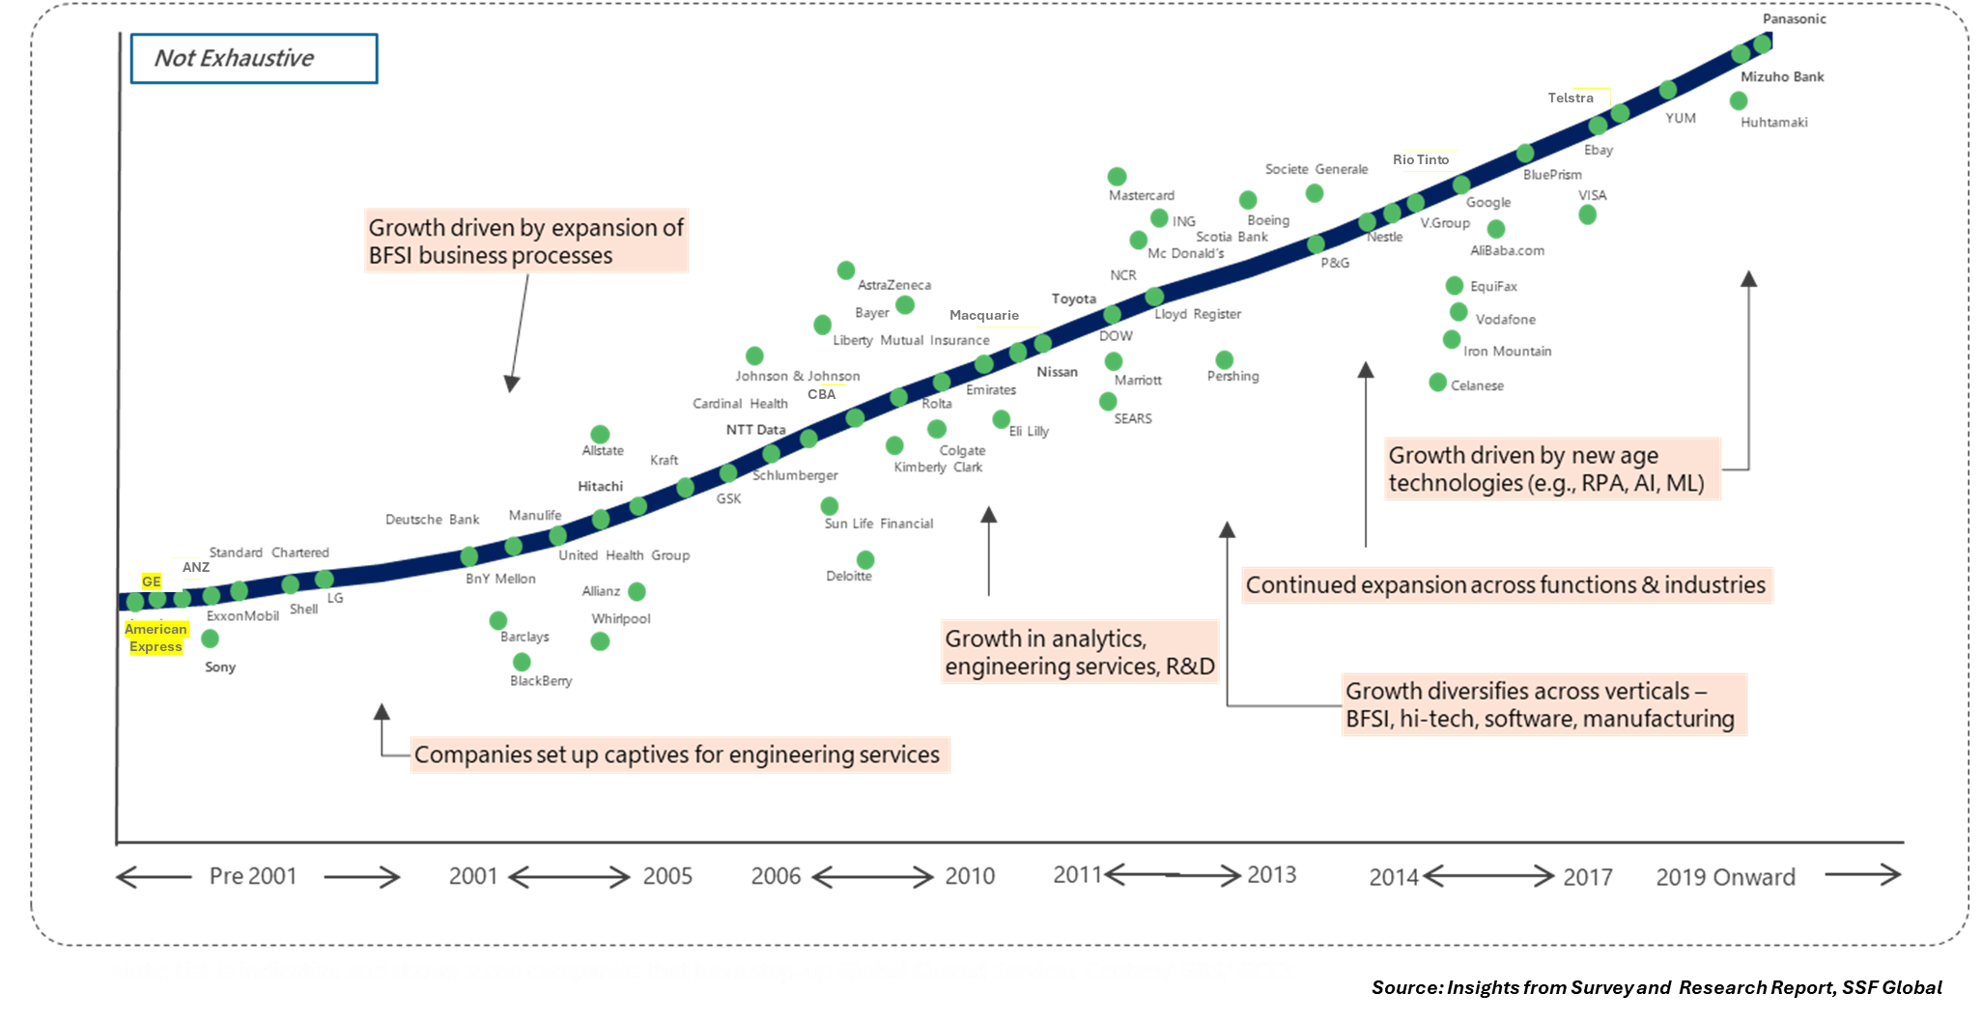
Evolution of the GCCs in India

Slide 6

Building India
as the
GCC Hub

Slide 7

GCC
TWO Cs: Collaboration & Capability
Ecosystem
Enterprise
Inhouse
Technology
People
Business
Global Collaboration & Capability HUB

Slide 8

THE Strategic Asset
Business Model &
Competitive Edge
Agility &
Risk Management
Intellectual Property &
New Products

Slide 9
GCC Maturity Model from SSFGlobal
Collaboration
Capability
L5
Enterprise Centre
L4
Strategic Centre
L3
Value Centre
Commitment
L2
Service Centre
Competitive Advantage
L1
Ops Centre
RISETM to NextGen Enterprise Centre

Slide 10

Process Chain
FP&A, Insights /Decision Enabler
Analytics
Financial/ Management
Reporting
Accounting
Revenue, Opex, Mth/Qtr Close
Operational
AP, AR, Recs
Transaction to…. Transformation

Slide 11
Value Chain
Value Add Services
Revenue Assurance
Functional Excellence
Accounting Accuracy
Transaction Processing
Timeliness
Cost Reduction
P&L and B/S Impact
Control & Compliance
Risk Mgmt.
First Pass
Accuracy
Process Metrics to Business KPIs
Centre of Excellence (CoE) & Centre of Expertise (CoEx)

Slide 12

The Opportunity for CAs & Advisors
80,000+ CAs already embedded in the GCC landscape
F&A - Role Model or Guinea Pigs
Tier-2 cities are booming (About 25% of new ones)
CAs and Advisory firms can lead the design, governance, and branding of these new-age Centres
However, requires Mindsets Shift
Enterprise Mindset (Accounting to Commercial & Business)
Disruption As Usual (DAU) Mindset (MD/ CM)
Experience as a Service Mindset (Touchpoints to Journey)
Entrepreneurial Mindset (Develop & Nurture Ecosystem)

Slide 13
Career Opportunities
Process Specialist
Project Manager
Transformation Lead
Digital Champion
Program Leader
Delivery Head
Functional SME
Transition Lead
ERP Champion
Business Leader
Process Leader

Slide 14
"If you don’t define your identity, it will be defined for you.
GCCs must lead their own narrative."
Thank You
Let’s build not just Centres…Let’s build bold, global brands.
+91 99588 40404
rakeshs@quintesglobal.com

